Slide 1

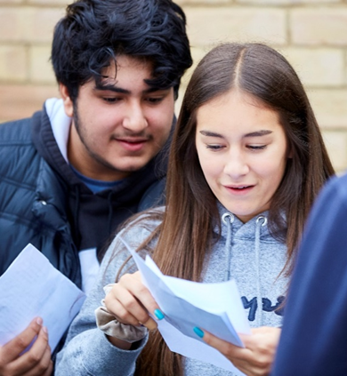
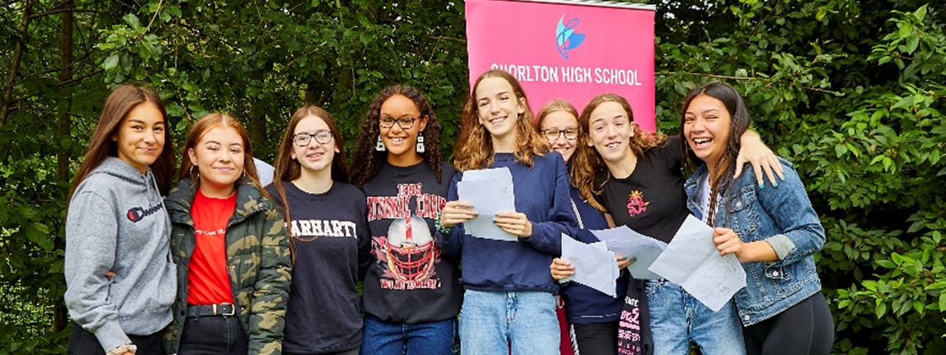




Post 16
Options Evening
2019

Slide 2
Introductions
The Year 11 Team: 2019-20
Mrs Sarwar: Head of Year 11
Mrs Baxter: Learning Mentor
Mrs Xiberras: Assistant Head teacher
Ms P Banger: Deputy Head teacher
Fire Alarm…..

Slide 3
Class of 2018 – where are they now?
RPA
The government expects ALL students to stay in some form of education or training until they are 18.
We work hard to make sure all our students secure positive destinations

Slide 4
Future job growth (2)
Source: Oxford Economics
Notes:
Pie chart shows the distribution of the new jobs referred to in the previous slide across sectors
Shows dominance of service sector and specifically higher skilled professional roles, business support services and leisure activities such as hotels, food and retail.
Also note that self-employment is an option in many of Manchester’s growth sectors
Manchester is an enterprising place – many opportunities to start your own business or work for a smaller company

Slide 5


We know that generally speaking:
4/5 Level 1 to 4’s
Move onto Level 1 courses
Traineeships
Foundation Learning
SOME Level 2 Apprenticeships
6+ Level 4 to 6’s
INCLUDING Level 4 in English + Maths
Move onto Level 2 Vocational courses
Level 2 Apprenticeships
Some may be offered level 3
8+ Level 5/6/7’s and above
INCLUDING level English + Maths
Move onto A Levels
Level 3 Vocational courses
Level 3 Apprenticeships

Slide 6

CEIAG - Guidance Community
Careers Advisor – Ms J Patrick
Works every Tuesday + Friday
Based in the Careers room - Library
Life skills teachers & Lessons
College applications
Personal Statements
Kudos
Form Tutors & Year 11 team
Key messages – deadlines
Open Evening / Day reminders
School References
DRIVE College Application Process
You!
Librarians
Make appointments
Oversee Careers Library

Slide 7
College Application Process
Last year CHS placed 100% of the Y11 students in colleges or in training – competition is high!
Students who were organised, prepared and worked hard nearly ALL got their first choice college.
We also have a professional responsibility to ensure references and information given to colleges is accurate and honest.
There is a lot of support in the completion of applications but we expect students to meet deadlines.

Slide 8
College Application Process
DATE | EVENT
September / October | College presentations in Life Skills lessons. Publication of College Open Day dates and times. Careers interviews.
November | Completion of Application forms (students MUST apply for more than TWO). Completion of school references.
25th November | DEADLINE for completion of Application forms.
January | Workshops on ‘Interview’ skills. Apprenticeship launch
The Tuesday morning assembly is a crucial forum for sharing with Year 11 information about Open Days, deadlines and important news. Students must attend registration and assembly

Slide 9
Study Habits
Our students are competing nationally!
Success has come for students who have got into good habits early on – study SMARTER – not Harder !!!!!
Help us DRIVE INDEPENDENT STUDY HABITS
SHOULD be working for up to 2 /(3) hours a night Monday to Thursday and Sunday - PURPOSEFUL practice!
SHOULD be using school books – acting on feedback
SHOULD be starting to revise – after school / Independently
SHOULD be using GCSE Pod / BBC Bitesize / Doddle / My Maths
SHOULD be drafting a revision plan for CEE exams
SHOULD be working on their applications and future choices….

Slide 10
CEEs - College Entry Exams
Start: Monday 4th November
Finish: Friday 15th November
18th to 22nd November – Art exams (5hrs)
Students will sit exams in all GCSE subjects
THERE IS NO STUDY LEAVE, this recreates the reality of the summer examinations where pupils attend lessons until they’ve completed their examinations
This window will be used by a number of curriculum areas to complete revisit exams / complete NEAs / cover content

Slide 11
CEEs
These replace our Mock Exams
The results may be shared with FE colleges on request
Results will be shared on 17th December.
This examination period allows our staff to assess performance and ensure that any personalised support packages are put in place – linked to PLC’s
Gives students a realistic understanding of the demands

Slide 12
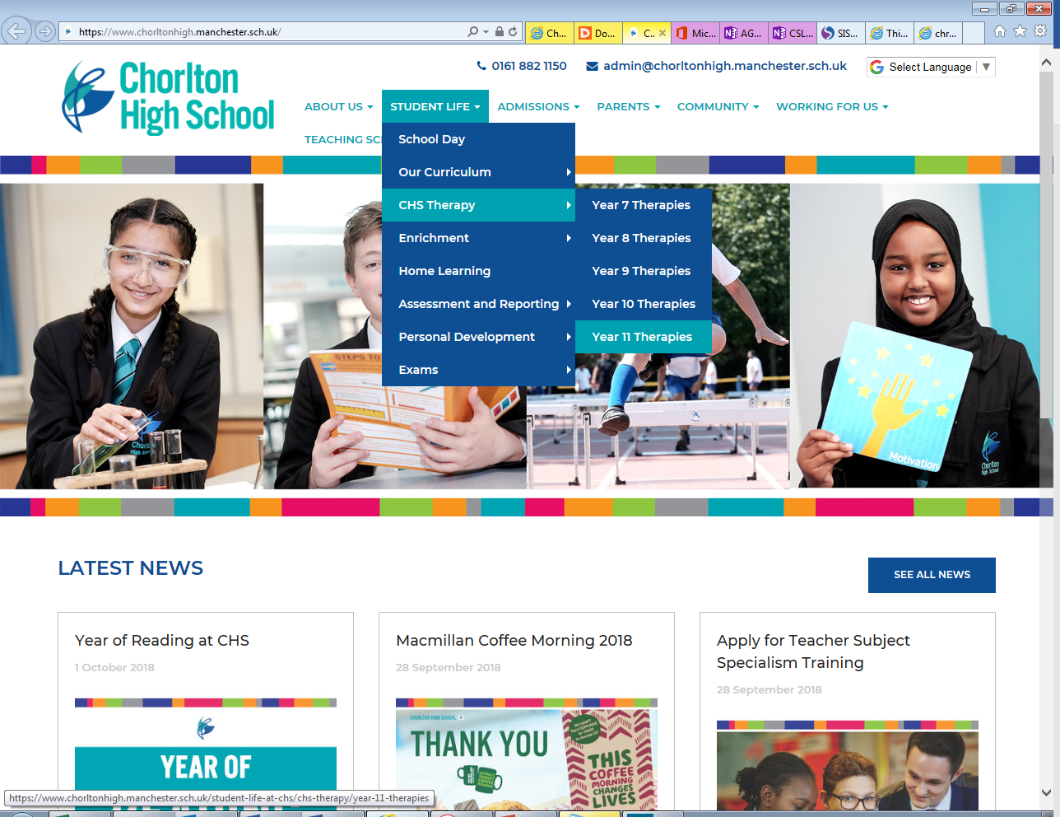

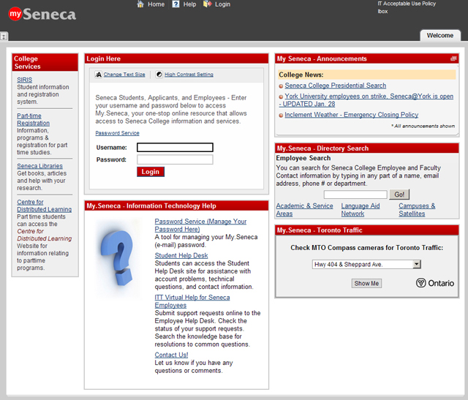

Revision resources…

Slide 13


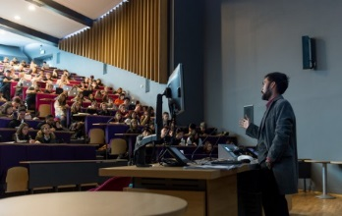

What’s available AFTER SCHOOL for English?
Every other Thursday, there is English revision available. These sessions are split into targets so that students are getting targeted support with their English revision. These run each Thursday 2.45-3.45pm.
The alternate week independent English revision is set
Once a half term there will be a LITERATURE REVISION QUIZ NIGHT!
Starting next half term there will be one lecture each half term, pushing students’ understanding of the Literature texts BEYOND what they’ve learnt in the classroom.
There will be pizza revision evenings running from 4.30-6.30 starting in the Spring term.

Slide 14

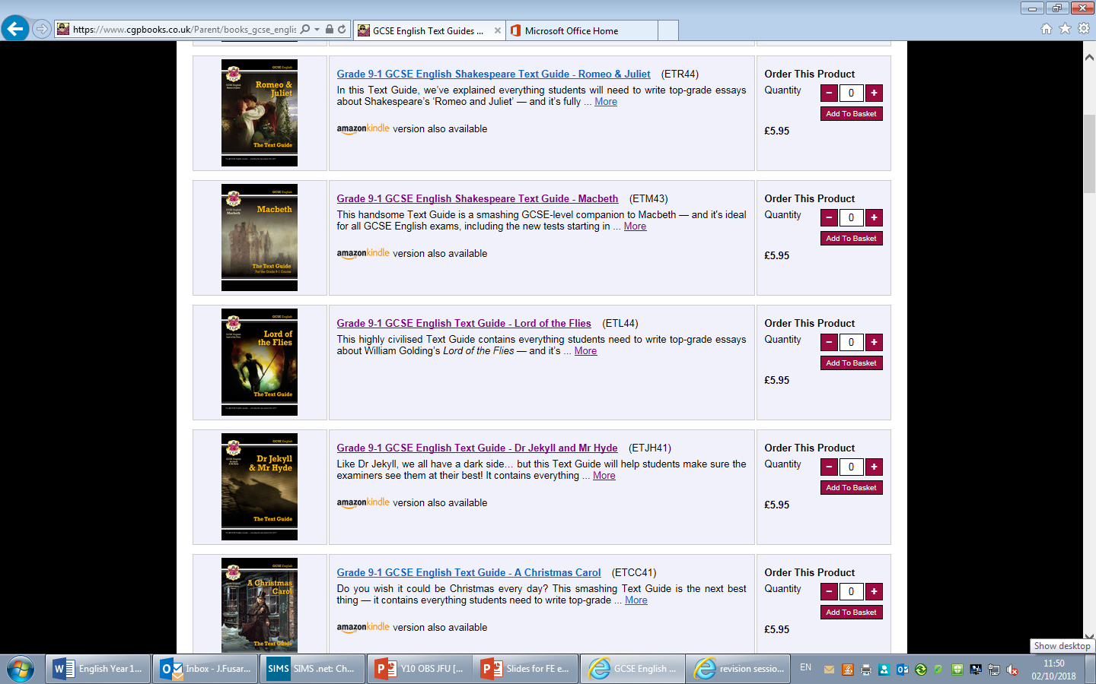
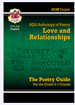
What revision guides are the best to buy?
We recommend the CGP revision guides. The ones designed specifically for the exam board AQA.
We will have some available for sale at Student Services from next half term. Students can purchase these through school for a cheaper price.

Slide 15
HOW should students revise English?
For Language, -READ as much as they can! Both fiction AND non fiction ideally.
DOWNLOAD the FREE GUARDIAN APP and read an article a day in the lead up to the exams.
One of the texts will be from the 19th century, so reading a 19th century novel can also help as it exposes them to the type of language they will be faced with. We have a number of these texts in the ENGLISH OFFICE that students are more than welcome to borrow.
For Literature, it’s really important that students have a FULL UNDERSTANDING of each of the texts: MACBETH, JEKYLL AND HYDE, LORD OF THE FLIES and of course, the LOVE AND RELATIONSHIPS cluster of 15 poems.
Creating revision cards based on plot, themes and characters is a good place to start.
They can get sample exam questions from their teachers and anything additional they complete will be marked.
They should complete exam questions in TIMED, EXAM conditions
College Entry Exams
For English, students will be sitting a Language Paper 1 exam AND a Language Paper 2 exam.
To prepare for this, students could use some of the tips on this slide!

Slide 16


HOW should students revise English?
Tips
Revising regularly is key – particularly for Literature. We will be revising the key areas in lessons but it is VITAL that students retain the Literature content ahead of the exams and sometimes we may not re-visit a topic for a month or two which is why it is important for students to be revising these topics at home, to help with this ☺
Being independent – both in lessons, working hard and also at home – ensuring that independent reading and revision is happening to promote success.
Using time effectively – English can be difficult, and it requires stamina in the exam as they have a lot to do. Timed tasks at home can help with this – either revision activities or homework tasks.

Slide 17



There is Maths revision after school Wednesday Week B for an hour, to mark practice papers and revise key topics. This is a drop-in available for all students
Maths GCSE

Slide 18
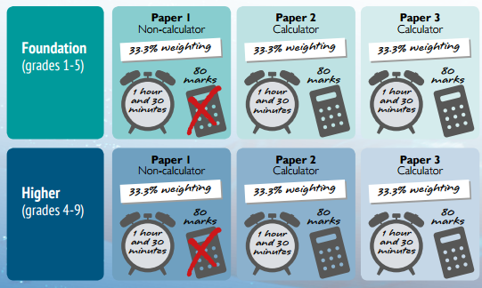










Assessment & grading is more rigorous than ever with 3 papers over 3 weeks from the end of May
It is so important that pupils know their calculator, as there are 2 papers that need one. Every calculator is different and this is the one we recommend:
The Casio FX-83GT Plus which is readily available from:
Tesco
Asda
Argos
Online from Amazon

Slide 19

The first College Entry paper for Maths will be on the ELE day on Friday 23rd October.
Students will be sitting the first paper before half term which allows students to revise for the first paper and fully reflect on this, before taking the other two in mid November.
You can support your son/daughter by ensuring that they are doing the following:
Completing tasks assigned on Mathswatch.
Students should be completing a 10-15 min Mathswatch as part of their independent revision’ in the 2/3 weeks before the first college entry paper. This is linked to topics on the paper.

Slide 20
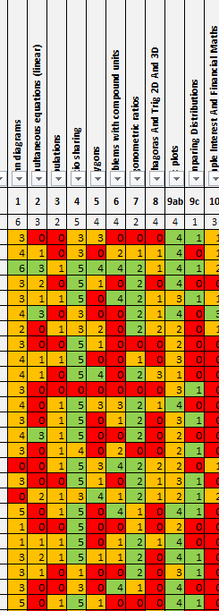

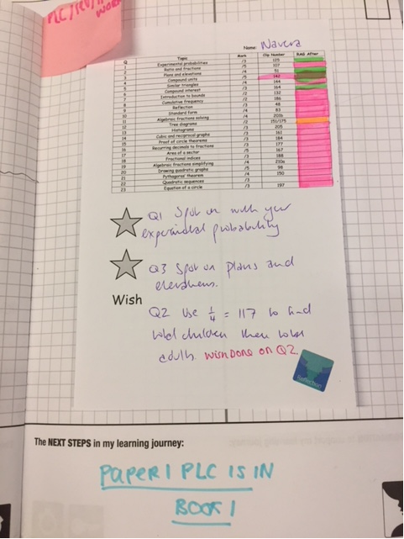

2) Responding to their personal feedback.
Detailed feedback is provided after every assessment so pupils know what topics they need to revise. Every question is rated red/amber/green and linked to Mathswatchvle.com for independent study of developing areas.

Slide 21
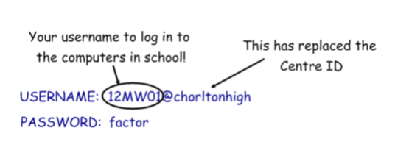
A compilation of videos that are graded
and lots of worksheets!
Previous year 11s have found this really
useful, it’s a portable revision tool you
can always have on your phone or tablet
All year 11 should know exactly how to log on.
https://vle.mathswatch.co.uk/vle/
Login details:

Slide 22
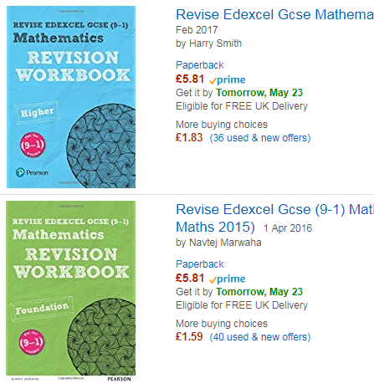
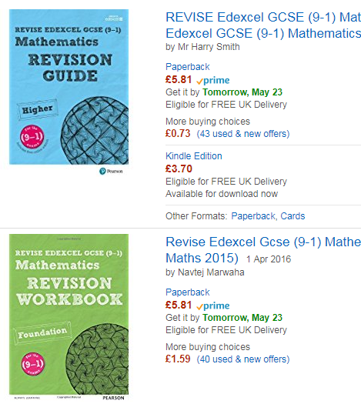
The recommended revision guide and accompanying workbook is a useful addition to revision resources and is an easy way for students to show their revision and ask for advice from their teachers.
£2.50 each
in student services

Slide 23

Achievement Team
ISP coaching – Achievement team
Workshops to TEACH students how to revise!
Breakfast revision sessions before GCSE exams.
Work with class teachers to help support students.
Motivational events / Careers events
Assist with College Application process
Drive Wellbeing and relaxation activities
Encourage students to use the ‘Habits of successful students at CHS’
Esteeming experiences to reward continued effort

Slide 24
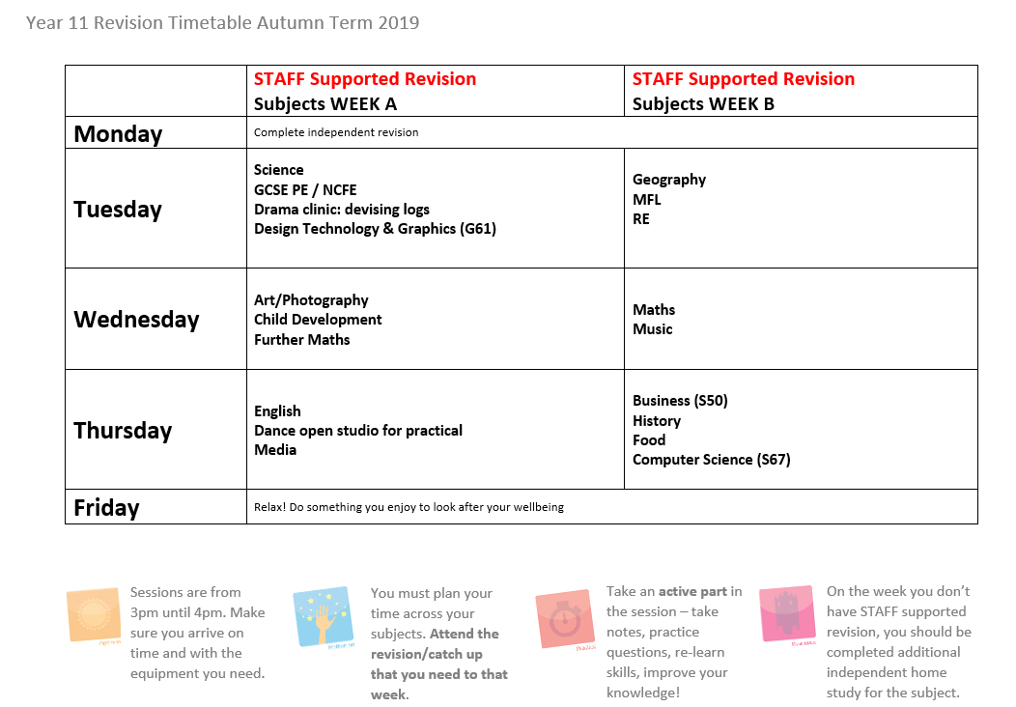

Slide 25
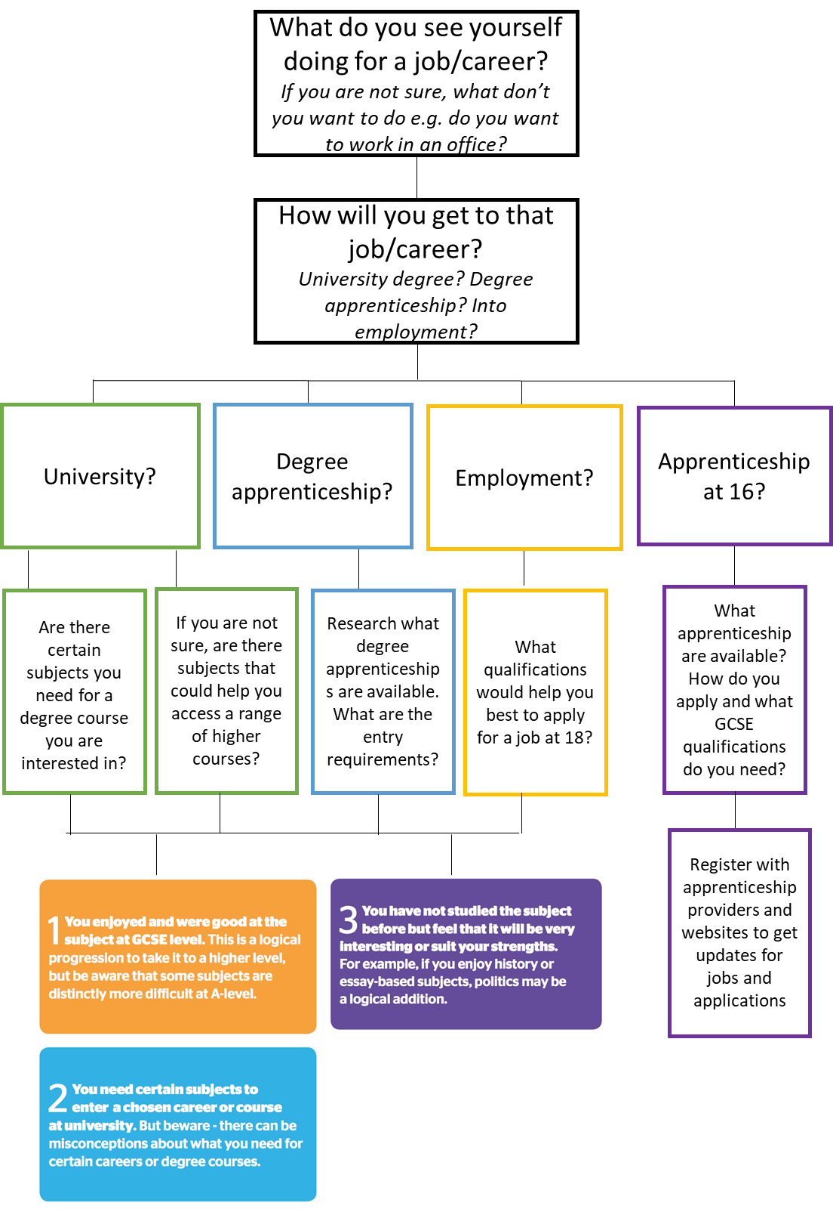
Helping choose the correct courses
Ask questions about possible careers
What can you see yourself doing?
What are you interested in?
What do you not want to do?
Be informed about pathways and potential routes – things have changed a lot
Help them research courses and find out information, or direct towards someone who can help with this
What do they want to continue to study?
What subjects do they enjoy most? Or least?
Any new subjects that link in?
What is best for you?

Slide 26
Calendar
We will also send out regular updates and reminders

Slide 27
Key Date:
Wednesday 23rd October
4pm – 6.30pm
Y11 Parents Evening

